Slide 1

touchdevelop cross-platform app creation on mobile devices
Tom Ball, Sebastian Burckhardt, Juan Chen, Michał Moskal
Manuel Fähndrich, Peli de Halleux, Nikolai Tillmann
Microsoft Research and Peter Müller ETH Zürich
PLDI 2013 Tutorial

Slide 2
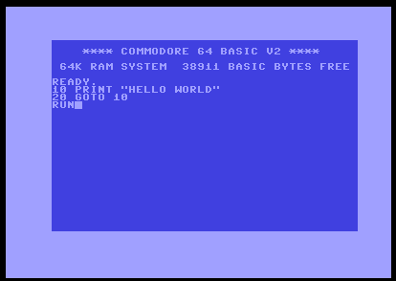
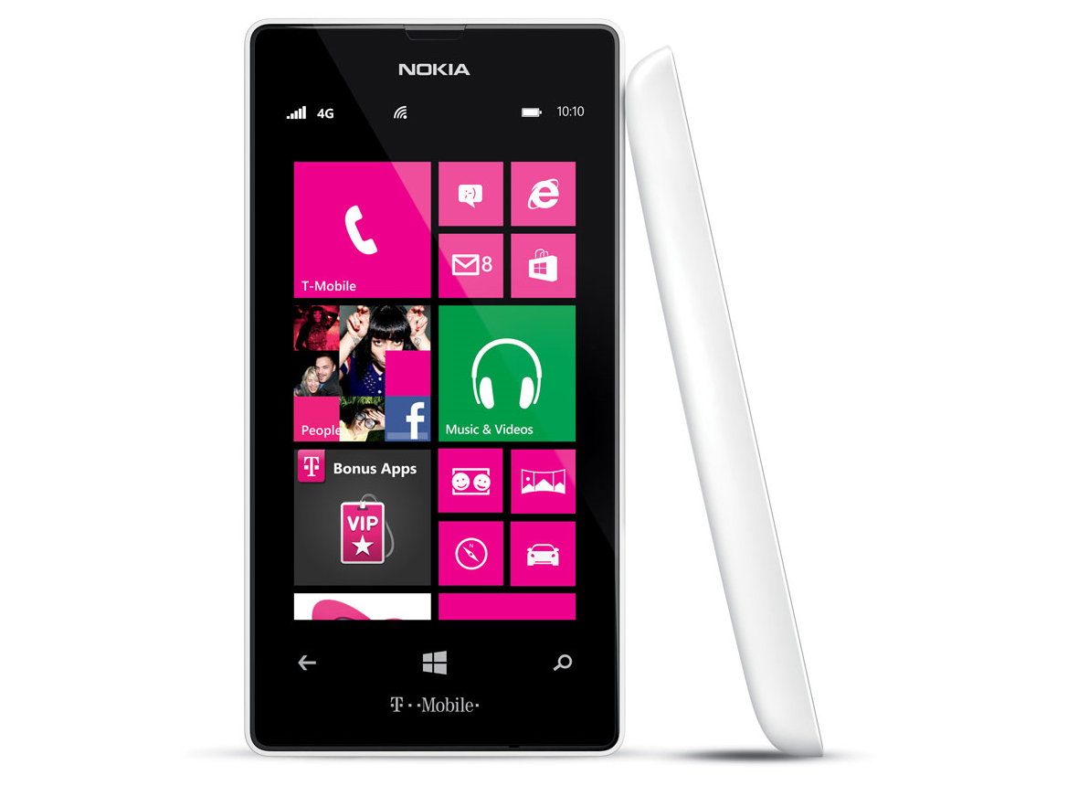
Notes:
touchdevelop:
bringing the joy of programming from early computers to modern touch devices

Slide 3

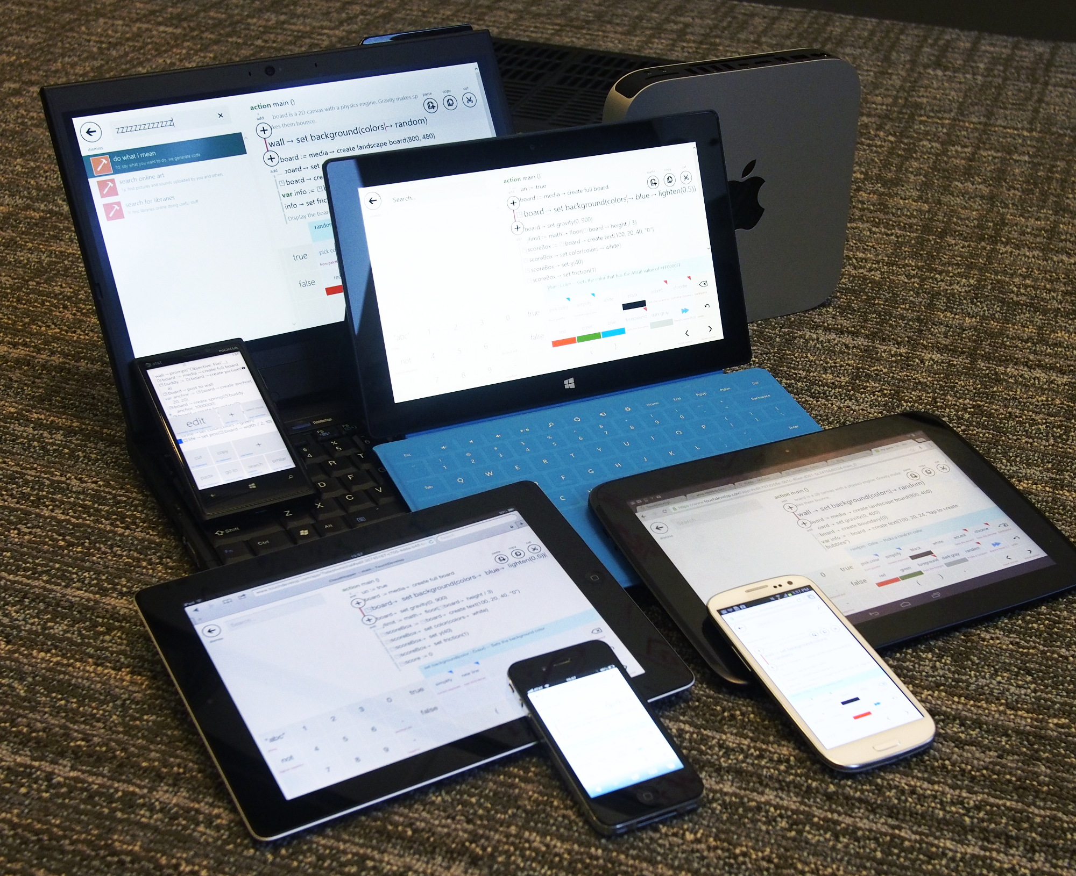

mission: democratize programming
touchdevelop: BASIC for all devices and the web
(or Bourne Shell, AppleScript, VBA, Excel Macros, …)

Slide 4
what’s in it for you?
Demo!
touchdevelop makes programming easier
total beginners
non-professional developers
pro-developers (prototyping)
Research with touchdevelop
delivery of PL features (cloud sessions, execution)
analysis of development process and programs
computer science education
Notes:
So try to put yourself in the shoes of someone who doesn’t have a PhD and is not a professional developer ;)
After the demo I’ll get to the doing the research part.

Slide 5
touchdevelop
demo
the hub, the language, the editor, publishing
scripts written by users
Notes:
WinPhone
Hello world; 10 times; Get current location, draw map
iPad
* Game – throwing monster + Publish + web app
* Hub; TouchInvaders
Computer
Rex synthesizer - 44 lines, live edit, library +5 lines; show lambda expressions; say about async
Show set/ordered type

Slide 6


share and export
one-tap share
export
submission to Windows Store and Windows Phone Store
requires developer account (free for students via Dreamspark)
app needs to pass a certification process
touchdevelop.com/apps

Slide 7
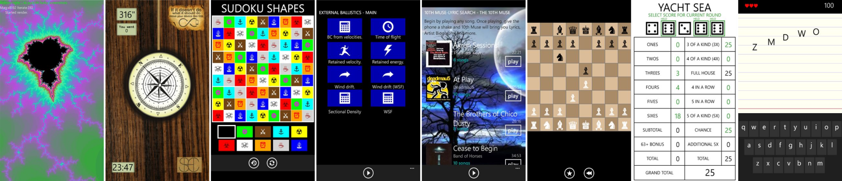
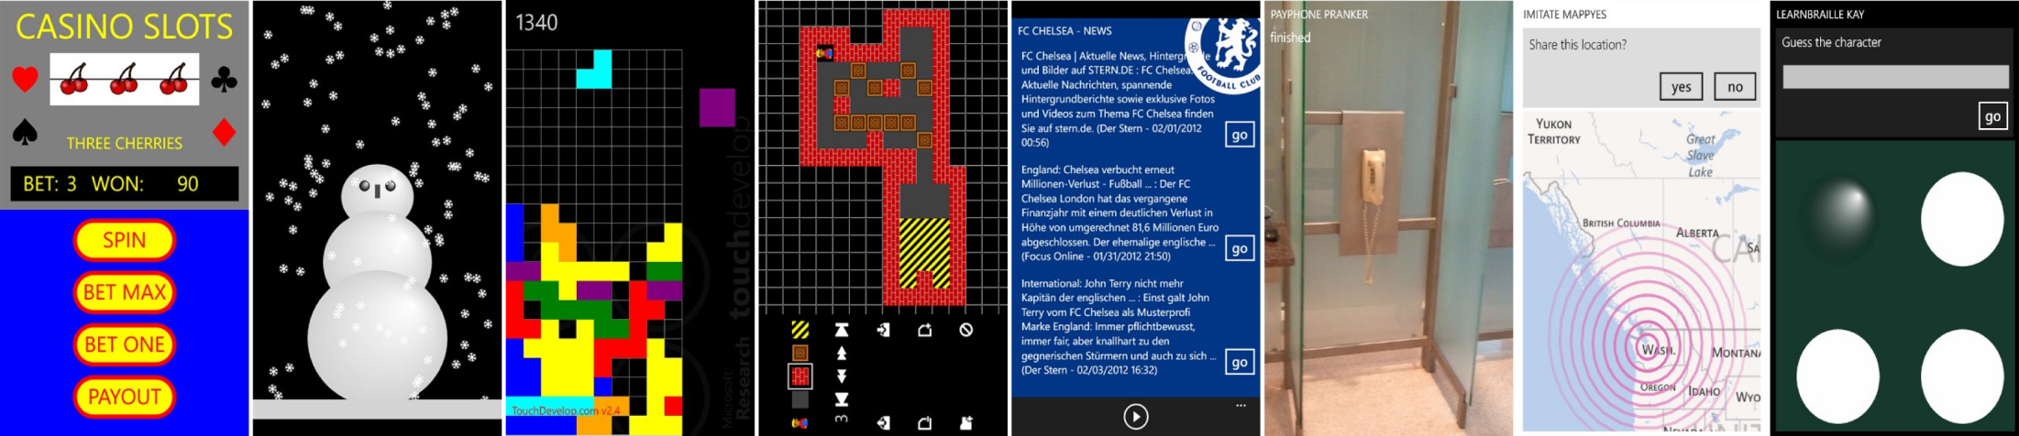
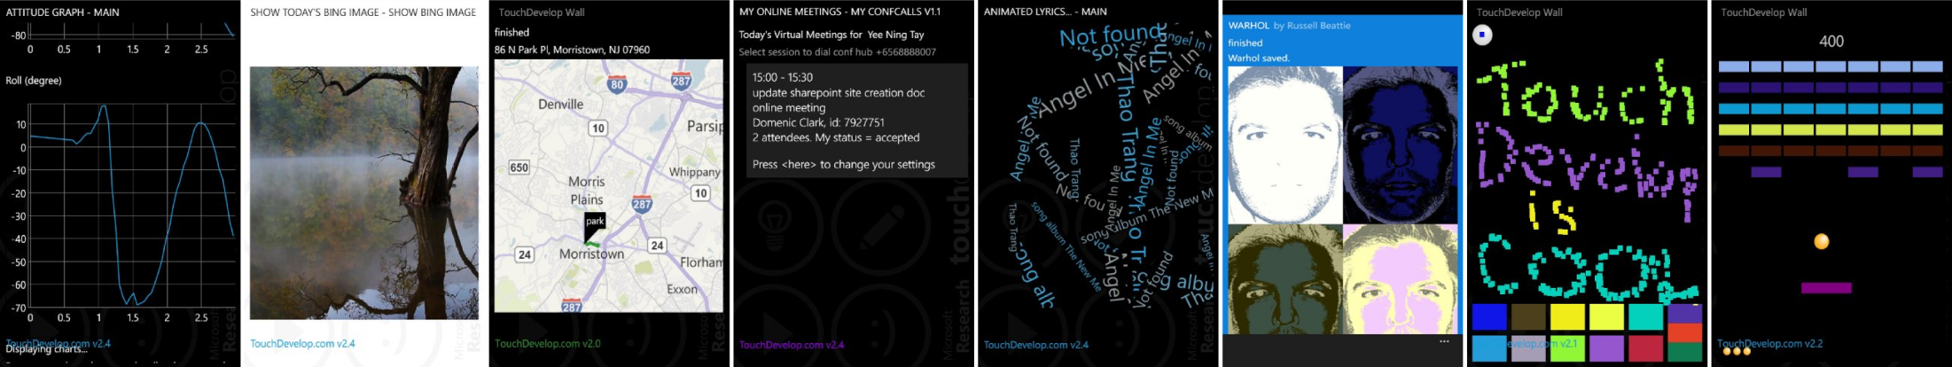
touchdevelop.com
300,000+ app downloads
90,000+ registered users
30,000+ published scripts
330+ apps in stores

Slide 8
touchdevelop
the langauge

Slide 9
language + editor
typed language + semi-structured editor
statements edited as trees
expressions edited as sequences of tokens
static first order type system
parametricity via module system (libraries)

Slide 10
module system / libraries
script can be marked as library and published
public actions and types they use are exported
if A references B which references C, then A can replace C with C’, including type substitutions

Slide 11
lambda expressions
lexical, by value scoping
always eta-expanded (but can be *rendered* differently) avoids error reporting problems
set of predefined function types

Slide 12
abstract syntax
script ::= meta-info decl* decl ::= action | page | event | global | library | record action ::= private? action sig stmt* event ::= event sig stmt* page ::= private? page sig init stmt* display stmt* sig ::= id (id : type)* returns (id : type)* global ::= var id : type flag* record ::= cloud? (object | table | index | decorator) keys (id : type)* values (id : type)* stmt ::= expr | // comment | if expr then stmt* else stmt* | loop do stmt* | boxed stmt* loop ::= while expr | for id < expr | for each id in expr expr ::= token* (where sig stmt*)*

Slide 13
touchdevelop
the research
something for you

Slide 14
research challenges we recently addressed
code synthesis from keywords
modern approach to designing and programming user interfaces
dealing with privacy concerns in touchdevelop Windows Phone app
automatic ranking of scripts for novelty
Cloud sessions
Cloud execution

Slide 15
mine code repository
loads of data available via REST
scripts (with history information), users, comments, tags, likes, etc.
https://www.touchdevelop.com/help/cloudservices
ASTs of scripts exposed in JSON format
https://www.touchdevelop.com/docs/bazaarastof

Slide 16
for cloud plug-ins sky is the limit!
early prototype in the works with ETH will define more extensibility points; need input!
export to other language, platform, etc. embedded devices, robots, various cloud services
import/generate scripts from other sources
code analysis (correctness, performance, style, …); continuous!
observe user interactions; help them learn programming
collaborative editing/diff+merge

Slide 17
touchdevelop
what’s coming
sooner or later

Slide 18
next in the tutorial
API overview
program state shared in the cloud
cloud off-loading of execution
example research collaboration (analysis)

Slide 19
TouchDevelop APIs and Apps

Slide 20
API Design
Simple and “big step”
Avoid call chaining to keep lines short
Most APIs are synchronous
API fallbacks: when a sensor or a functionality is not available emulate or ask the user to do the action
API are annotated with platform requirements (accelerometer) to allow filtering based on script target platform
Spaces and Unicode characters allowed (virtual keyboard)!
Notes:
Mutating API do not return values
Api names were picked to be user friendly
Common singleton names (data, code, libs) shortened to Unicode symbols to save space
Pro: makes the code more readable
Cons: confusing for the beginner
All APIs are synchronous although the underlying implementation might be async or even require the app to shut down and restart. (senses->current location, senses->take camera picture)
API fallback: when a sensor or a functionality is not available emulate or eventually ask the user to do the action:
Copy to the clipboard supported in IE
Other browser: show textbox and ask user to copy himself
Accelerometer values inferred from inclinometer on Android or mouse position on laptops
API are annotated with platform requirements (accelerometer) and data flow (source, sink) to allow filtering based on script target platform.
many API arguments have a meaningful default argument (not just 0 or null)
senses->text to speech(senses->record microphone)
no enums but instead acceptable values can be encoded for parameters

Slide 21
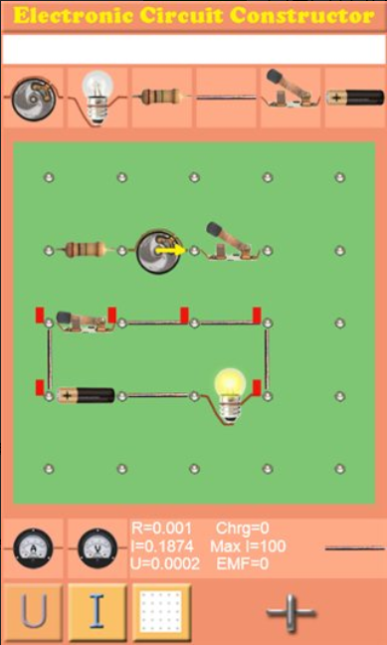
http://www.touchdevelop.com/aslwa

Slide 22

board
sprite-based
objects have speed, gravity, friction (physics engine)
game loop (timer event)
touch events on sprites

Slide 23
board apis
Board→create text Create a new text sprite.
Board→create rectangle Create a new rectangle sprite.
Board→create ellipse Create a new ellipse sprite.
Board→create picture Create a new picture sprite.
Board→create sprite set Create a new collection for sprites.
Board→create boundary Create walls around the board at the given distance.
Board→create obstacle Create a line obstacle with elasticity (from sticky to complete bounce)
Board→create anchor Create an anchor sprite.
Board→create spring Create a spring between sprites

Slide 24
Classes of APIs
Local
General purpose: math, collections, picture, song, game engine (board), JSON, XML
Device specific: camera, touch, accelerometer, other local sensors (compass, gyroscope, etc.)
Non-local
Device specific: phone, GPS, NFC
Internet: search, social, web services, web requests

Slide 25
accelerometer
electronic component that measures tilt and motion
angle device is being held at
movements such as rotation
motion gestures such as swinging, shaking, and flicking
detect whether the phone is held in “portrait” or “landscape” mode
control games and other applications (such as music player) by moving or shaking the phone

Slide 26
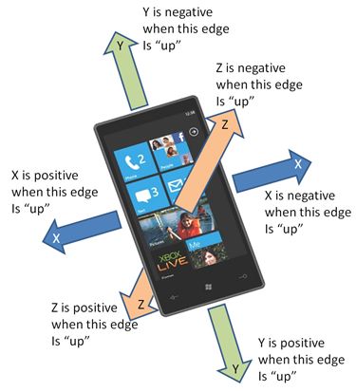
3d coordinates
Y is positive when this edge
is “up”
Z is negative when this edge
is “up”
X is positive when this edge
is “up”
X is negative when this edge
is “up”
Z is positive when this edge
is “up”
Y is negative when this edge
is “up”

Slide 27
events
shake
phone face up
phone face down
phone portrait
phone landscape left
phone landscape right

Slide 28
apis
Senses→acceleration quick Gets filtered accelerometer data using a combination of a low-pass and threshold triggered high-pass on each axis to eliminate the majority of the sensor low amplitude noise while trending very quickly to large offsets (not perfectly smooth signal in that case), providing a very low latency. This is ideal for quickly reacting UI updates.
Senses→acceleration smooth Gets filtered accelerometer data using a 1 Hz first-order low-pass on each axis to eliminate the main sensor noise while providing a medium latency. This can be used for moderately reacting UI updates requiring a very smooth signal.
Senses→acceleration stable Gets filtered and temporally averaged accelerometer data using an arithmetic mean of the last 25 'optimally filtered' samples, so over 500ms at 50Hz on each axis, to virtually eliminate most sensor noise. This provides a very stable reading but it has also a very high latency and cannot be used for rapidly reacting UI.

Slide 29
Smartphone DEMo

Slide 30
https://www.touchdevelop.com/platforms

Slide 31

web
internet connectivity
downloading, uploading
Json, RSS, XML
search

Slide 32
apis: connection
Web→open connection settings Opens a connection settings page (airplanemode, bluetooth, wiki, cellular)
Web→is connected Indicates whether any network connection is available
Web→connection name Gets a name of the currently connected network servicing Internet requests
Web→connection type Gets the type of the network servicing Internet requests (unknown, none, ethernet, wifi, mobile)

Slide 33
apis: download/upload
Web→download Downloads the content of an internet page (http get)
Web→download picture Downloads a picture from internet
Web→download json Downloads a web service response as a JSON data structure (http get)
Web→download sound Downloads a WAV sound file from internet
Web→download song Create a streamed song file from internet (download happens when playing)
Web→upload Uploads text to an internet page (http post)
Web→upload picture Uploads a picture to an internet page (http post)

Slide 34
apis: formats
Web→xml Parses the string as a xml element
Web→json Parses the string as a json object
Web→rss Parses the newsfeed string (RSS 2.0) into a message collection
Web→url encode Converts a text string into an url-encoded string
Web→url decode Decodes a string that has been url-encoded
Web→html encode Converts a text string into an HTML-encoded string
Web→html decode Decodes a string that has been HTML-encoded

Slide 35
Documentation
Crowd-sourced documentation

Slide 36
next in the tutorial
API overview
program state shared in the cloud
cloud off-loading of execution
example research collaboration (analysis)

Slide 37





Cloud Sessions in TouchDevelop
Sebastian Burckhardt, Manuel Fähndrich, Daan Leijen, Benjamin P. Wood

Slide 38
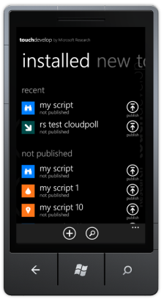
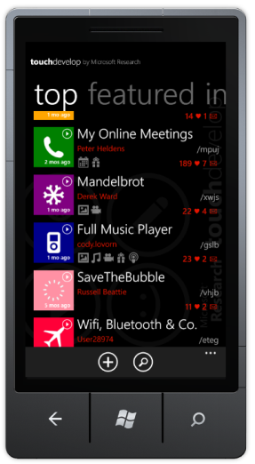
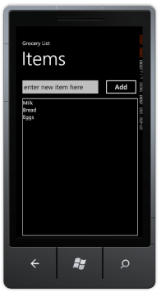
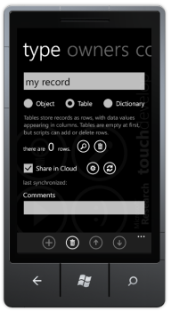
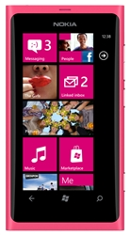
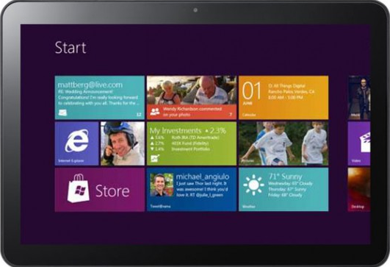
Sharing Data Across Devices
Sharing data makes apps more social, fun, and convenient.
Examples: Games, Settings, Chat, Favorites, Ratings, Comments, Grocery List…
But implementation is not simple as we would like.

Slide 39
Examples of cloud-connected apps
Personal Publishing
Sync and Backup
Data Collection
Blog
Facebook Wall
Website
Music
Video
SkyDrive
Feedback
Surveys
High Scores
Collaboration
Games
Transactions
Remote Control
OneNote
Shared Lists
Shared Calendar
Shared Spreadsheet
Real-time
Turn-based
Store
Auction
Matchmaking
Home Control
Robotics
Smartglass
Media Player

Slide 40
Sharing Data Across Mobile Devices
Cloud Storage & Cloud Servers
Updates Queries
Updates Queries
Standard Solution: Clients call web service to query and update shared data
Mobile App
Mobile App

Slide 41
Standard pattern: hard to get right
// get data from server
try {
localdata = query()
// work with local copy
localdata.manipulate()
// send data to server
try {
localdata.savechanges()
}
catch(ConflictException e)
{
localdata.resolve(e)
}
}
catch(ConnnectionException e)
{
// retry? Give up?
}
local changes?
what changes?
how?
what if connection fails?
Notes:
Consistency is ad-hoc and error prone
Must keep record of changes
Must track enough information to resolve conflicts
Queries are not precise
Multiple queries use different server state
Result of queries may not reflect local changes

Slide 42
Sharing Data Across Mobile Devices
Cloud Storage & Cloud Servers
Updates Queries
Updates Queries
Problems:
if connection is slow or absent, program is unresponsive.
complex code for handling errors, retrying, caching, etc.
Mobile App
Mobile App

Slide 43
How to make it simpler?
Simple apps should be simple to code.

Slide 44
Observation
Structured data is often organized into small “packages”
grocery list, high scores, collaboration document, game state
Idea: Organize data into small databases called sessions.
Each session small enough to be fully cached on device!

Slide 45
Cloud Session Model
Cloud Sessions
H
F
B
Session A
G
D
C
sync when connected
sync when connected
Local replica always fast and available
Like shared memory, but without cache misses
Seamless offline support
But: Consistency?
Mobile App
Mobile App
Session A
Session A
Read Write
Read Write

Slide 46
How Much Consistency do we Need?
Strong Consistency
Updates are conditional on very latest state
Examples: bank accounts, seat reservations, …
See: classic OLTP (online transaction processing)
Updates require server roundtrip (CAP theorem)
Eventual Consistency
Updates are not conditional on very latest state
Examples: Ratings, Shopping Cart, Comments, Settings, Chat, Grocery List, Playlist, Calendar, Mailbox, Contacts …
We use eventual consistency for sessions

Slide 47
Demo
Let’s create a “birdwatching” app
We want to record how many times we saw each bird
At first, let’s not worry about consistency.

Slide 48
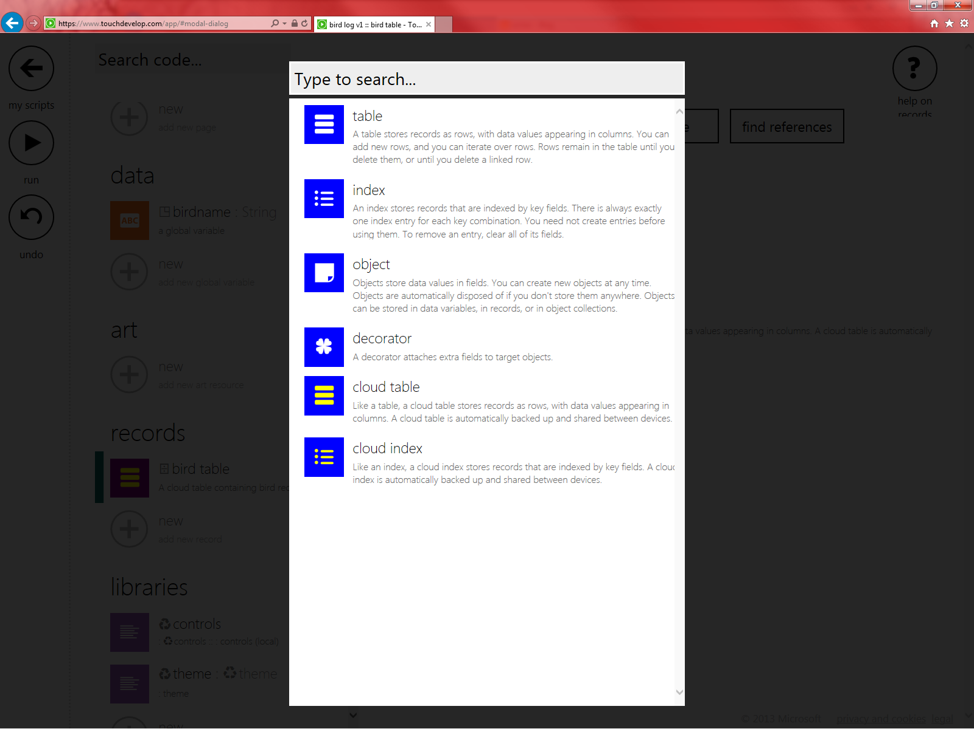
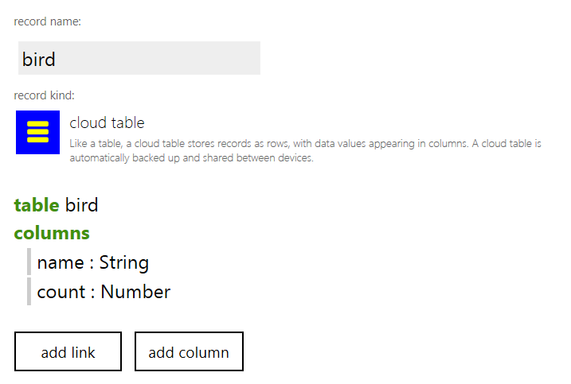
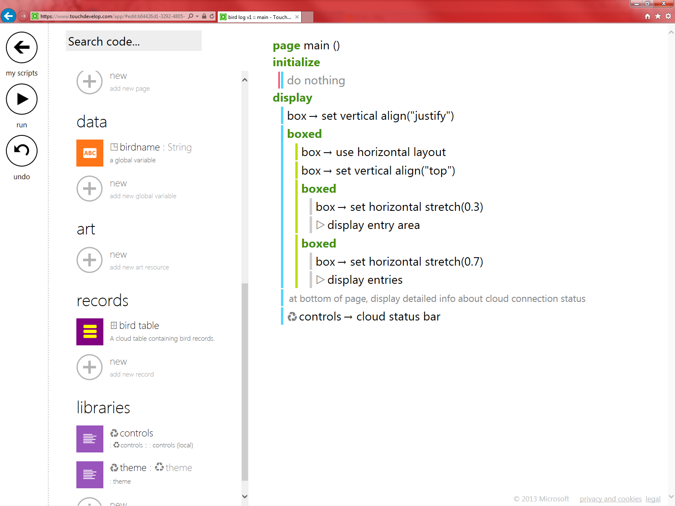
First Step: Create Cloud Table/Index
For starters, we create table with two columns

Slide 49
Second step: Write core functions
private action add sighting ( name : String) do var found := false for each birds in ⌹ bird table where birds → name → get → equals(name) do if not found then birds → count → set(birds → count → get + 1) found := true else do nothing if not found then var newbird := ⌹ bird table → add row newbird → name → set(name) newbird → count → set(1) else do nothing
private action clear all sightings () ⌹ bird table → clear

Slide 50
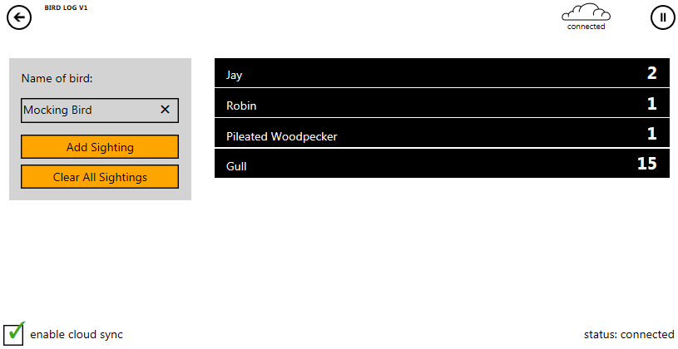
Third step: Write GUI code
Can use new page/box model in TouchDevelop

Slide 51
It seems to work!
Demo: Play with app

Slide 52
BUT… consistency?
The app actually has two consistency anomalies (behaviors that are probably not desired).
But wait… we haven’t even explained yet what the consistency model is…
Let’s do that now.

Slide 53
System Model
Client A
Client B
Client C
As clients execute, they read and update data
Reads read current state of local replica
Updates must be propagated
read
update
read
read
read
read
read
read
read
read update
read
update
update
update
read
read
read
read
read update
read
update
update
update
update
update
update
update
update
read
read
read

Slide 54
System Model
Client A
Client B
Client C
Group operations into rounds
Separation lines = “idle moments” (no code executing, event queue empty)
Updates of each round are propagated atomically
A1
B1
C1
B2
A2
B3
A3
B4
C2
B5
A4

Slide 55
System Model
Server interleaves client rounds that stream in.
device A
cloud
device B
A1
A1
B1
A2
B1
B2
A3
A2
B3
A4
A3
B4
B2
B3
A4
B4

Slide 56
System Model
Server streams interleaved sequence back to clients.
cloud
device B
Client adjusts replica state during idle moments.
A1
B1
B1
B2
A2
A3
B3
B2
B4
B3
A4
B4

Slide 57
How to understand current state?
State = Last Seen Prefix + …
cloud
device B
At each point, client has knowledge of some server prefix
A1
B1
B1
A2
B2
A3
B3
B2
B4
B3
What state does B4 see when it executes?
A4
B4

Slide 58
How to understand current state?
State = Last Seen Prefix + Unconfirmed local rounds
cloud
device B
At each point, client has knowledge of some server prefix
Client appends local rounds it has not seen confirmed
Local state seen = effect of the updates in the rounds, applied in that sequence.
A1
B1
B1
A2
B2
A3
B3
B2
B4
B3
Sequence seen by B4: A1;B1;A2;A3;B2;B3;B4
A4
B4

Slide 59
What does it mean?
cloud
device B
Code may see only a only a subsequence of all rounds that eventually precede it.
A1
B1
B1
A2
B2
A3
B3
B2
B4
B3
Current state when originally executing B4: A1;B1;A2;A3;B2;B3;B4
Sequence preceding B4 in final order: A1;B1;A2;A3;B2;B3;A4;B4
A4
B4

Slide 60
What does it mean?
Must write robust code:
Updates must make sense even if some “earlier” rounds are not visible yet!
cloud
device B
Code may see only a only a subsequence of all rounds that eventually precede it.
A1
B1
B1
A2
B2
A3
B3
B2
B4
B3
Current state when originally executing B4: A1;B1;A2;A3;B2;B3;B4
Sequence preceding B4 in final order: A1;B1;A2;A3;B2;B3;A4;B4
A4
B4

Slide 61
Quiz 1 (write-write atomicity)
Consider two clients executing these two actions. Is it possible to reach the “oops” statement?
Cloud integer x := 0;
Cloud integer y := 0;
action_1()
{ x.set(1);
y.set(1); }
action_2()
{ if (x.get() != y.get())
print “oops”; }

Slide 62
Quiz 1 (write-write atomicity)
Is it possible to reach the “oops” statement? NO. This code is robust. The two updates “x.set(1)”, “y.set(1)” are part of the same round.
action_1()
{ x.set(1);
y.set(1); }
action_2()
{ if (x.get() != y.get())
print “oops”; }

Slide 63
Quiz 1 (write-write atomicity)
Visualization: see entire round, or nothing of it
device A
cloud
device B
x.set(1);
y.set(1);
x.set(1)
y.set(1)
if (x.get() != y.get())
print “oops”;
OR
device A
cloud
device B
x.set(1);
y.set(1);
x.set(1)
y.set(1)
if (x.get() != y.get())
print “oops”;

Slide 64
Quiz 2 (read-write atomicity)
Consider two clients executing these two actions. Is it possible to have a final state of x == 1 ?
Cloud integer x := 0;
action_1()
{ x.set(x.get() + 1); }
action_2()
{ x.set(x.get() + 1);
}

Slide 65
Quiz 2 (read-write atomicity)
Is it possible to have a final state of x == 1 ? Yes. This code is not robust.
Cloud integer x := 0;
action_1()
{ x.set(y.get() + 1); }
action_2()
{ x.set(y.get() + 1);
}

Slide 66
Quiz 2 (read-write atomicity)
Visualization:
device A
cloud
device B
B1
x.set(y.get() + 1);
x.set(y.get() + 1);
x.set(1)
x.set(1)

Slide 67
How to make the code robust?
Solution: Use x.add(1)
Cloud integer x := 0;
action_1()
{ x.add(1);
}
action_2()
{ x.add(1);
}
device A
cloud
device B
B1
x.add(1);
x.add(1);
x.add(1)
x.add(1)

Slide 68
We should fix this in our Bird App.
private action add sighting ( name : String) do var found := false for each birds in ⌹ bird table where birds → name → get → equals(name) do if not found then birds → count → add(1) found := true else do nothing if not found then var newbird := ⌹ bird table → add row newbird → name → set(name) newbird → count → set(1) else do nothing
private action clear all sightings () ⌹ bird table → clear
Fixed.
Can anyone spot the other “anomaly”?

Slide 69
We should fix this in our Bird App.
private action add sighting ( name : String) do var found := false for each birds in ⌹ bird table where birds → name → get → equals(name) do if not found then birds → count → add(1) found := true else do nothing if not found then var newbird := ⌹ bird table → add row newbird → name → set(name) newbird → count → set(1) else do nothing
private action clear all sightings () ⌹ bird table → clear
Fixed.
Can anyone spot the other “anomaly”?

Slide 70
Consistency Anomaly
Suppose both clients call add_sighting(“jay”) when there is no such entry yet
End up with duplicate entry!
device A
cloud
device B
r = add_row()
r.name.set(“jay”)
r.count.set(1);
r = add_row()
r.name.set(“jay”)
r.count.set(1);
create(r₁)
r₁.name.set(“jay”)
r₁.count.set(1)
B1
create(r₂)
r₂.name.set(“jay”)
r₂.count.set(1)

Slide 71
Anti-Pattern
If (not exist) create
Always a source of potential problems because element may already exist, but local node may not know about it yet.
Possible solution: detect duplicates, merge them
Even better idea: use a cloud index (a special kind of key-value data structure where all entries are pre-initialized)

Slide 72
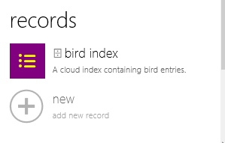
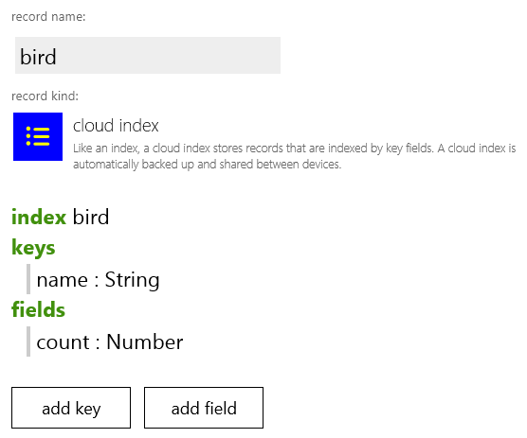
bird log v3
Change “bird table” to “bird index”

Slide 73
bird log v3
Less code needed!
private action add sighting ( name : String) do var found := false for each birds in ⌹ bird table where birds → name → get → equals(name) do if not found then birds → count → set(birds → count → get + 1) found := true else do nothing if not found then var newbird := ⌹ bird table → add row newbird → name → set(name) newbird → count → set(1) else do nothing
private action clear all sightings () ⌹ bird table → clear
private action add sighting ( name : String) do var entry := ⌹ bird index → at(name) entry → count → add(1)
private action clear all sightings () ⌹ bird index → clear

Slide 74
Indexes + Tables = Relational Data
Tables
Define entities
Row identity = Invisible primary key
Indexes
Can define key-value store
Can define relations (using multiple keys)

Slide 75
Indexes + Tables = Relational Data
Example: “is friends with” relation
index friends keys a : ⌹ user b : ⌹ user fields value: Boolean
table user columns name : String e-mail : String
…
private action make friends( user1 : ⌹ user, user2 : ⌹ user) do ⌹ friends index → at(user1, user2) → set(true)

Slide 76
Indexes + Tables = Relational Data
table customer columns name : String e-mail : String
…
Example: shopping cart
index cart keys who : ⌹ customer what : ⌹ product fields quantity : Number
table product columns name : String SKU : String
…
private action add to cart ( customer : ⌹ customer, product : ⌹ product) do ⌹ cart index → at(customer, product) → quantity → add(1)

Slide 77
Linked Tables
table customer columns name : String e-mail : String
…
table order links by : ⌹ customer columns …
by
customer1
order1
by
customer2
order1
by
customer3
by
order1
order1
by
order1
Cascading delete: When customer is deleted by user, all orders are automatically deleted also

Slide 78
In Preparation: Session Management
one private session for each script and user
Is the default session, if script does not specify
Contents are shared between devices by same user
one public session for each script
Contents shared between everyone running this script
any number of custom sessions
Created and managed by users
Each session has a “host” (the user that created it)
Can be public, private, or broadcast
Can manage access permissions for individual users

Slide 79
Planned Feature: Recover stronger consistency
Use ‘flush’ statement to block until all local rounds are confirmed by server.
Can be used to implement strong consistency.
But: hangs if no server connection (need timeout).

Slide 80
Our research papers behind it all
Eventually Consistent Transactions (ECT)
An abstract consistency model [ESOP ‘12]
How to formalize the consistency model?
How to visualize and implement consistency?
How to write programs for this model?
Revision Consistency
An implementation technique reminiscent of source control systems [ESOP ‘11,’12]
Cloud Types Defining Structured EC Data [ECOOP ’12]

Slide 81
Related Work
CRDTs (Conflict-Free Replicated Data Types)
[Shapiro, Preguica, Baquero, Zawirski]
Similar motivation and similar techniques
use commutative operations only
not clear how to do composition
Bayou
user-defined conflict resolution (merge fcts.)

Slide 82
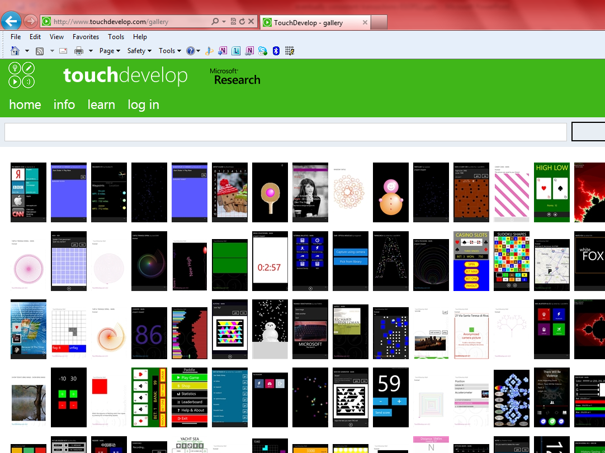
Claim: this is not too hard. Developers can write nice apps using these primitives.
How to evaluate claim: see what scripts our users write…

Slide 83
App ids
bird log v1 /xzpgzmjn
bird log v2 /tlwfhpwf
bird log v3 /mhuekiwn

Slide 84
Recovering stronger consistency
Everything we’ve shown so far is non-blocking.
Client program can actually not see in any way if connected to server or not.
Great for performance, robustness and offline operation
But, cannot do operations that require true arbitration (e.g. acquire a lock) at all, even if we are willing to sacrifice offline operation

Slide 85
Planned Feature: On-Demand Stronger Consistency
flush primitive blocks until local state has reached main revision and result has come back to device
Sufficient to implement strong consistency
Flush blocks –times out if server connection is not available.
flush (blocks)
(continue)

Slide 86
Recovering stronger consistency
While connected to server, we may want more certainty
flush primitive blocks until local state has reached main revision and result has come back to device
Sufficient to implement strong consistency
flush (blocks)
(continue)

Slide 87
Flush can be used to implement a lock
We don’t recommend you actually do this in practice. (why?)
lock: cloud string;
function Lock() { while(lock != my_id) { lock.setIfEmpty(my_id); flush; } }
function Unlock() { lock.set(“”); }

Slide 88
Cloud Table
cloud table E
(
link₁: table_type₁;
link₂: table_type₁;
)
{
col₁: cloud_type₁;
col₂: cloud_type₂;
}
Declares
Link columns
Regular columns
Initial value: empty
Operations:
new E(l₁,l₂) add new row (at end)
all E return all rows (top to bottom)
delete e delete row
e.f₁
e.col_{i}.op perform operation on cell
If e deleted: queries return initial value, updates have no effect

Slide 89
Cloud Index
Example:
Initial value: for all keys, fields have initial value
Operations:
A[i₁,i₂].val_{i}.op perform operation on value
entries A.val_{i} return entries for which val_{i} is not initial value
cloud array A
[
idx₁: index_type₁;
idx₂: index_type₂;
]
{
val₁: cloud_type₁;
val₂: cloud_type₂;
}

Slide 90
next in the tutorial
API overview
program state shared in the cloud
cloud off-loading of execution
example research collaboration (analysis)

Slide 91
Supporting Mobile Cloud Computing in TouchDevelop
Juan Chen
MSR RiSE

Slide 92
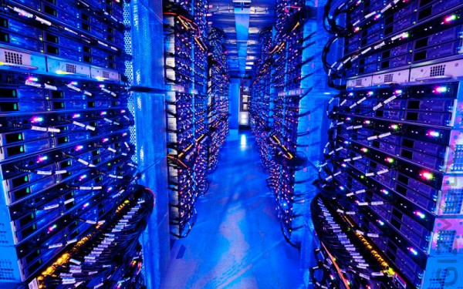



Mobile Cloud Computing (MCC)
Save
battery
time
data
Enrich functionality
apps

Slide 93
Challenges
Make offload decisions dynamically
Connectivity, battery status
Heterogeneous environments
Limited resources
Non-blocking data sharing between devices and cloud

Slide 94
Prior Approaches
Programmer annotations
MAUI [MobiSys 10]
CloneCloud [EuroSys 11]
Odessa [MobiSys 11]
Orleans [SOCC 11]
Weblet [Mobile Networks and Applications]
Tasklet [MCS 12]
Dpartner [Oopsla 12]
device
[Remotable]
M() {…}
…
…
Optimizer
Serialization
M()
Program state
(deltas)
Deserialization
MAUI
Address the 1st challenge but not the 2nd

Slide 95

MCC in TouchDevelop
TouchDevelop:
Customized language and programming environment
High level APIs
Building blocks
Targeted app
Computation intensive apps
Web data processing

Slide 96
Goal
More flexibility in decision making
Program abstraction
Programmer annotation + automatic inference
Static analysis + dynamic analysis
Optimize for battery, speed, data
Non-blocking data sharing
Asynchronous execution of offloaded code

Slide 97

Status
Programmer annotations
CanBeOffloaded Analysis
“cloud” action
M() {…}
…
…
Heap Analysis
M()
NodeJS Server
Automatic inference
Notification
Storage Server

Slide 98
Outline
Introduction
Static analyses
CanBeOffloaded: decide what can be offloaded
Heap analysis: decide what data needs to transfer
Cloud state in offloaded code
Asynchronous execution
Conclusion

Slide 99
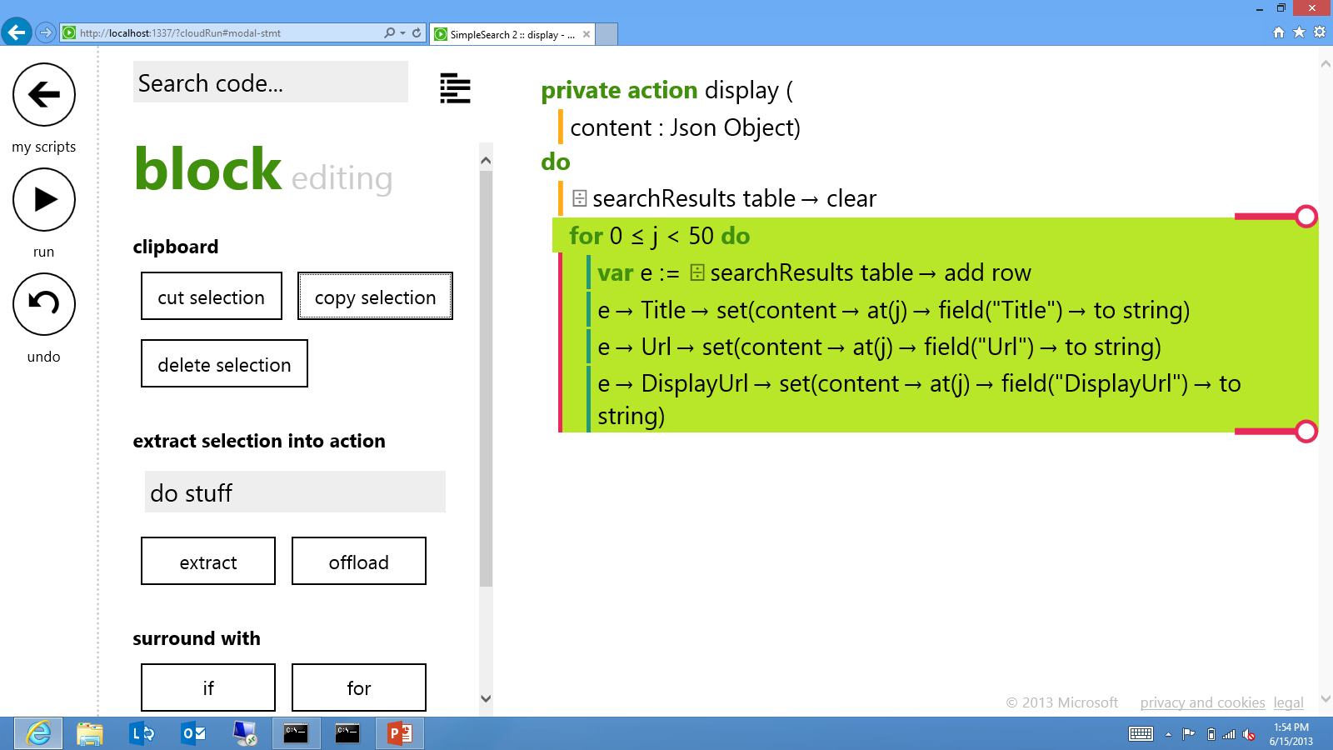
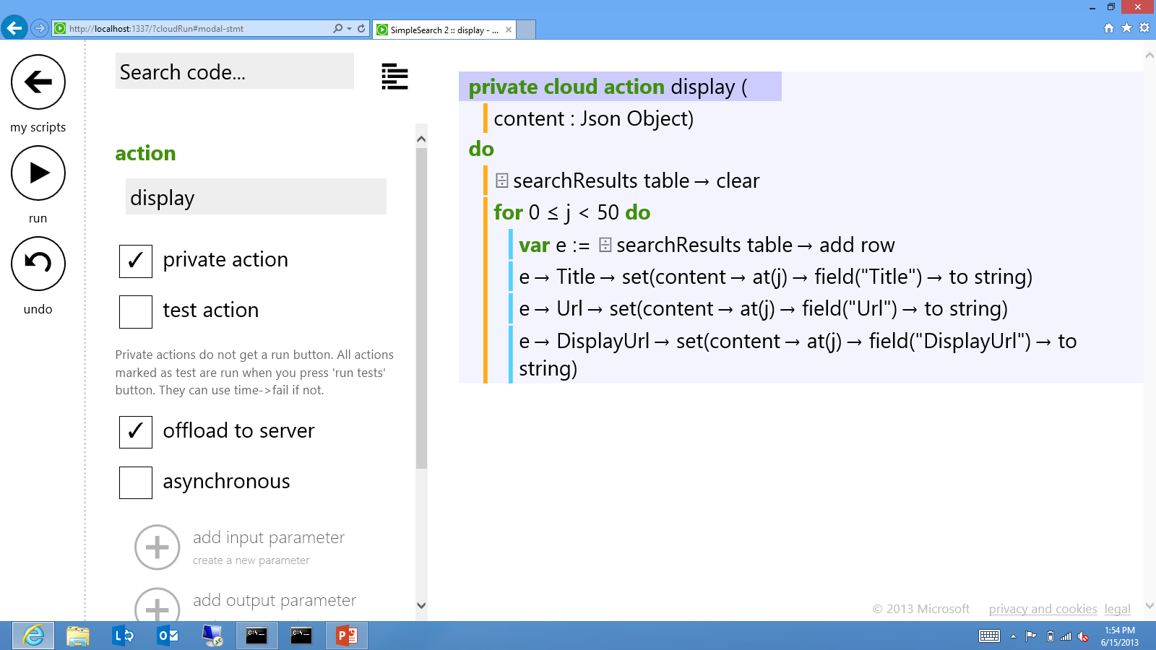
Annotations and Semantics
Offload a code block
Offload an action

Slide 100
CanBeOffloaded Analysis
post to wall
Integrated with the editor

Slide 101
Support Cloud State
Treated as another client of the storage server
“cloud” action
M() {…}
…
…
Stateless
M()
NodeJS Server
Storage server

Slide 102
Optimized---Data Prefetch
“cloud” action
M() {…}
…
…
M()
NodeJS Server
Storage server

Slide 103
Non-blocking (Asynchronous ) Execution
“cloud” action
M() {…}
…
…
Access only cloud data
M()
NodeJS Server
All synchronization happens here
Storage server

Slide 104
Share states other than cloud state
“cloud” action
M() {…}
…
…
M()
NodeJS Server
Session for
non-cloud states
Notification
Storage server

Slide 105
Demo

Slide 106
Conclusion
Mobile cloud computing in TouchDevelop
On-going work
Automatic inference
More flexible asynchronous execution
Other interesting research problems
Security
Privacy
For improving reliability

Slide 107
next in the tutorial
API overview
program state shared in the cloud
cloud off-loading of execution
example research collaboration (analysis)

Slide 108
TouchBoost
Static Analyses for TouchDevelop
Lucas Brutschy, Pietro Ferrara, and Peter Müller
Chair of Programming Methodology, ETH Zurich
Manuel Fähndrich, Michał Moskal, and Nikolai Tillmann
Research in Software Engineering, MSR Redmond

Slide 109
Motivation
Reliability
Programmers make errors
Traditional software engineering techniques do not help
→ How can we help them to write more reliable apps?
Performance
Mobile devices have strong resource limitations
→ How can we automatically improve the performance?
TouchBoost approaches these challenges using
Static Analysis

Slide 110
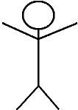
Overview
Mobile Device
Cloud
script
SAMPLE
TouchDevelop editor
Reliability analysis
warnings and examples
Development
Programmer
script
Performance analysis
Release
instrumented script
TouchDevelop runtime (local)
TouchDevelop runtime (cloud)
Use
End
user
execution

Slide 111
SAMPLE
Static Analyzer for Multiple Programming LanguagEs
Based on Abstract Interpretation
Generic in terms of…
Programming Language
Supports imperative, object-oriented, and functional programming
Abstract Domain
Multitude of abstract domains implemented:
Intervals, Octagons, Polyhedra, Shape Analysis …
Property
E.g., run-time errors, access permissions, information leakage

Slide 112
Part 1: reliability Analysis

Slide 113

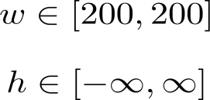
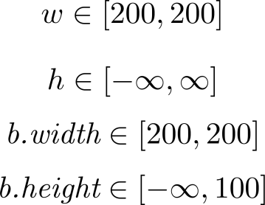
Reliability
1) Finding potential problems using Abstract Interpretation
$w := 200
$h := wall→ask_number
$b := media→create_board( $w, math→min(100,$h) )
Property violation: create_board.arg_h > 0
Challenges
Formal semantics of TouchDevelop
Find suitable abstractions for the state of mobile devices

Slide 114
Overview
TouchDevelop
Script
Execution Model
Abstract Domain
Compilation
Linking of Libraries
Sample Analyzer
Abstract semantics of the API
Intermediate Representation
Warnings

Slide 115
Abstract domain
A program state is abstracted by an element of…
Which objects can be referenced?
Possible heap IDs: Objects created, Environment, Fields
Which numeric values can a variable or heap ID take?
Can be instantiated with intervals, octagons, etc.
Which variables or heap IDs can be valid, which can be invalid?
Which expressions can be on the top of the evaluation stack?

Slide 116
Execution Model – Public methods
Public method 1
Public method 2
…
Public method N

Slide 117
Execution Model - Events
Public method 1
Public method 2
…
Public method N
Event 1
Event 2
…
Event N
Fixpoint Computation

Slide 118
Persistent Storage
Global variables in TouchDevelop are persistent between runs
Possible errors
Script does not initialize variables correctly on the first run
Script does not work after one or more runs

Slide 119
Execution Model – Persistent Data / Multiple Runs
Set persistent data Invalid
Public method 1
Public method 2
…
Public method N
Reset non-persistent data
Event 1
Event 2
…
Event N

Slide 120
Information on the Environment
Environment of the phone:
Media library, sensors, home network…
action main ()
media → songs → random → play
Correctly detected as an error
action main () if media → songs → count > 0 then
media → songs → random → play
else do nothing
Strictly a possible error, but should not be reported

Slide 121
Execution Model – Environment Assumptions
Set persistent data Invalid
Public method 1
Public method 2
…
Public method N
Reset non-persistent data
Reset environment
assumptions
Reset environment
assumptions
Event 1
Event 2
…
Event N

Slide 122
Preliminary Results
We have analyzed the 589 most recent published root scripts
Results
Timing: 0.39s per script on average
No warnings | Use of Invalid | Network access w/o checking | Arguments out of bounds | Other warnings | Partial analysis
300 | 241 | 62 | 61 | 28 | 145
51% | 41% | 11% | 10% | 5% | 25%
Notes:
Figures from April 26, 2013

Slide 123
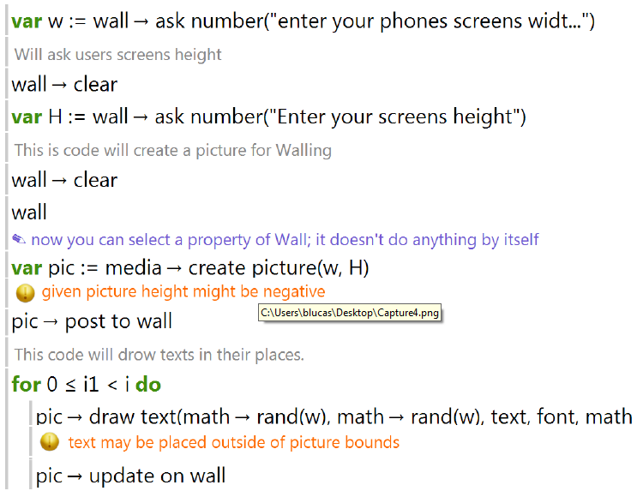
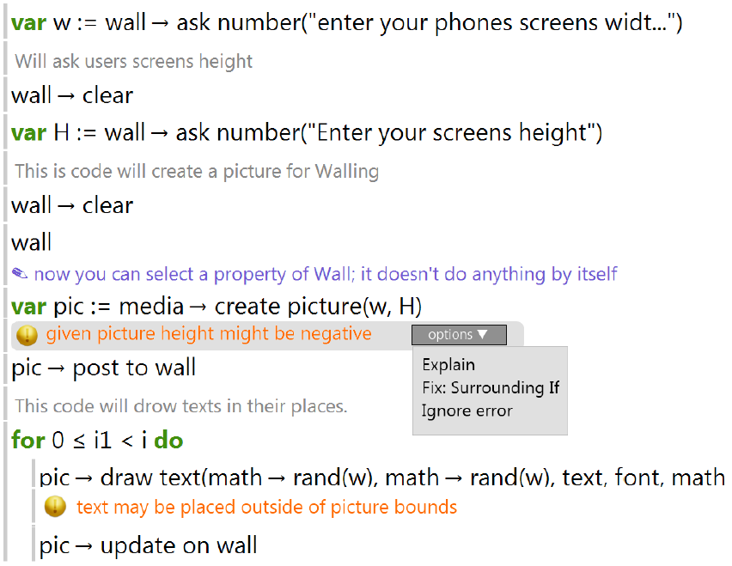
TouchDevelop Integration
Release reliability analysis as TouchDevelop plug-in
Analyze scripts every 10 seconds
Display most relevant warnings in editor
Offer explanations and fixes

Slide 124
Part 2: Performance Analysis

Slide 125
Automatic Performance Enhancement
Motivation: Mobile devices have…
Limited computing power
Limited battery runtime
Can we partially lift these limits by automatically moving
computations to the cloud?
Approach:
Statically determine (potentially) costly program parts
Dynamically decide whether to use the cloud

Slide 126
Board Game Example
code→compute_move(board,player)
Cost analysis
if (board.size > 4
and web.is_connected) {
libs.cloud.run(“compute_move”,board)
} else {
code.compute_move(board,player)
}
Instrumentation
Approximate cost of (parts of) TouchDevelop scripts
Approximate cost of running TouchDevelop in the cloud
Find partitions / slices with good cost balance
Challenges:

Slide 127
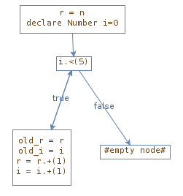
Cost Analysis: Approach
C = L(0) {true}
L(i) = 1 + L(i+1) {i ≥ 0, i < 5}
L(i) = 0 {i < 0}
L(i) = 0 {i ≥ 5}
Cost Equation System (CES)
Parametric loop bounds
PUBS
Cost
Practical Upper Bound Solver
(E. Albert, P. Arenas, S. Genaim, G. Puebla. Closed-Form Upper Bounds in Static Cost Analysis. Journal of Automated Reasoning, 46 (2), pp. 161–203, 2011.)
Cost Model

Slide 128
Preliminary Results
We have analyzed 7,997 published scripts containing 3,263 loops
Results
Timing: 0.11s per script on average
Non-zero upper bound | Zero upper bound | No upper bound | Total
1,376 | 851 | 1,036 | 3,263
42% | 26% | 32% | 100%
Notes:
Figures from April 20, 2013:
Total scripts: 10k, for around 2k the compiler fails, so we have results for about 8k

Slide 129
Conclusion
TouchBoost aims at…
Improving programming experience
through error-reporting
Improving user experience
through more efficient & reliable apps
Educating lay programmers
through explanatory counter-examples

Slide 130
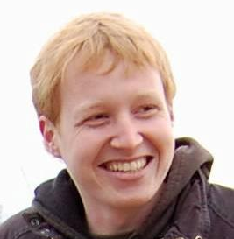





Personnel
Lucas Brutschy
PhD student
Pietro Ferrara
Post-doctoral researcher
Programming Methodology
Peter Müller
Full professor
Manuel Fähndrich
Senior researcher
Nikolai Tillmann
Principal RSDE
Redmond

Slide 131
questions?
touchdevelop.com
research.microsoft.com/touchdevelop

Slide 132
touchdevelop
backup slides

Slide 133
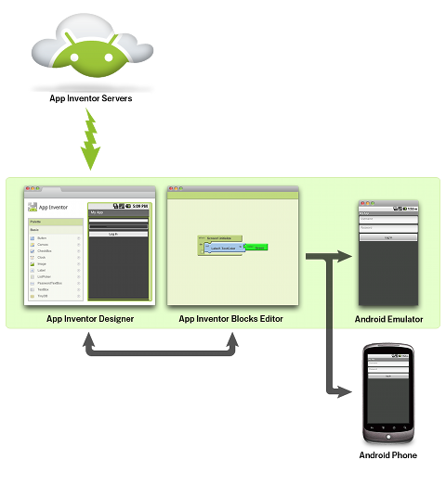
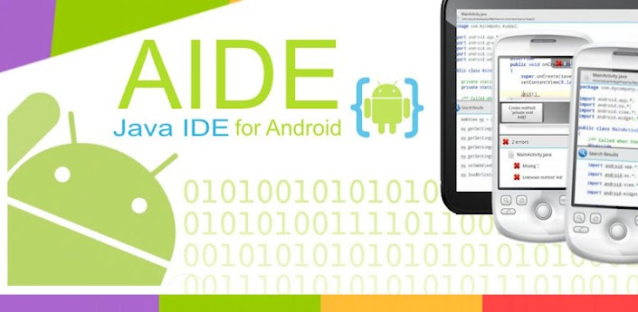
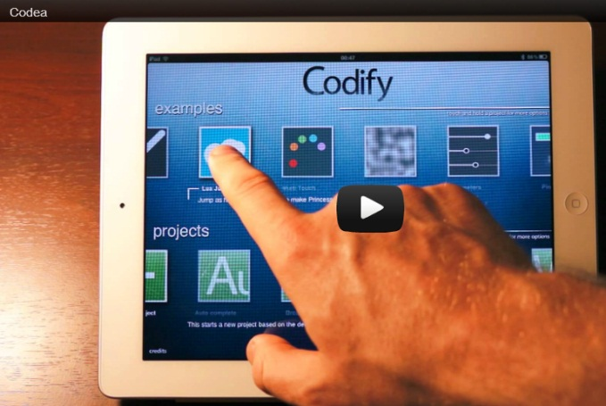
related approaches
PC – legacy development model
Android: AIDE, App Inventor, …
iOS: Codea
mobile development environments are becoming popular on all platforms
only touchdevelop embraces new devices (touchscreen, editor, language, social)

Slide 134
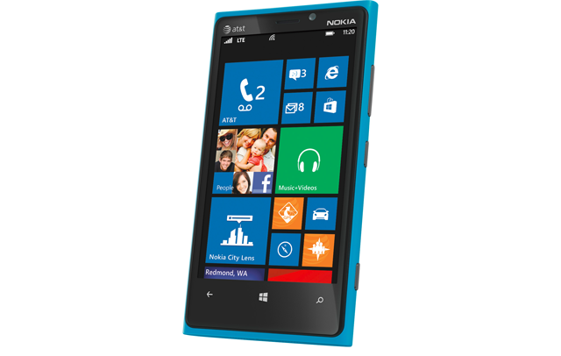

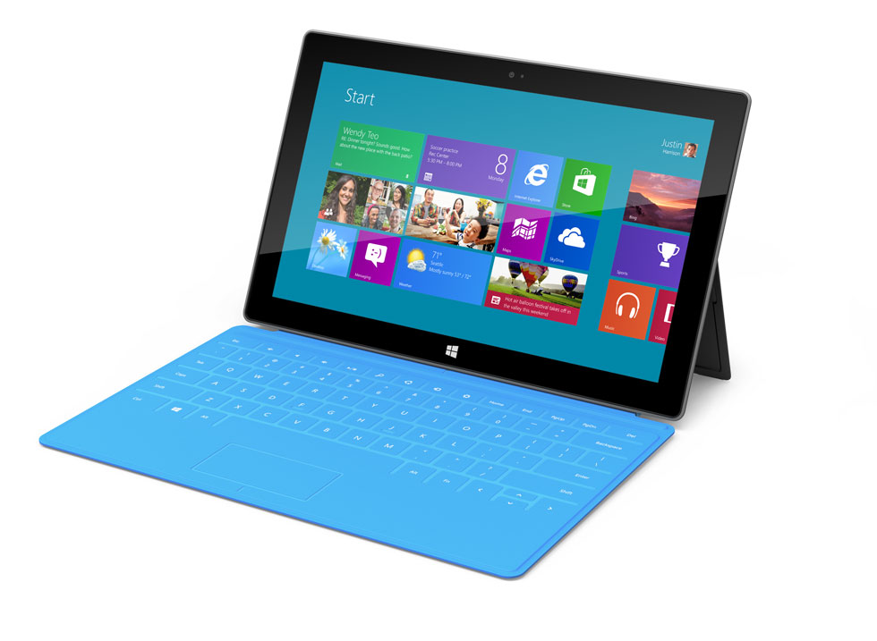



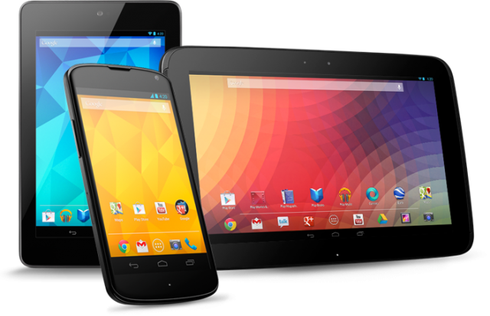
architecture
touchdevelop.com
.ts
RGB
0 24 143
RGB
0 188 242
RGB
0 216 204
RGB
127 186 0
RGB
186 216 10
RGB
255 175 0
RGB
255 140 0
RGB
232 17 35
RGB
244 114 208
RGB
155 79 150
Notes:
[dev hat]
Cloud stuff we can reuse, just need to change the protocol a bit.
The core experience of TD is editing code, there’s more though. This is why I was the one starting JS rewrite – I was responsible lang/editor on the phone since the beginning. Others did libraries, intelli sense, social etc.

Slide 135
the scale of things
152,000 lines of C#
12,000 lines of XAML
.js
60,000 lines of TypeScript
4,000 lines of CSS
130,000 lines of C#
(plus 10,000 lines of tools in C#)
RGB
0 24 143
RGB
0 188 242
RGB
0 216 204
RGB
127 186 0
RGB
186 216 10
RGB
255 175 0
RGB
255 140 0
RGB
232 17 35
RGB
244 114 208
RGB
155 79 150
Notes:
[dev hat]
Cloud stuff we can reuse, just need to change the protocol a bit.
The core experience of TD is editing code, there’s more though. This is why I was the one starting JS rewrite – I was responsible lang/editor on the phone since the beginning. Others did libraries, intelli sense, social etc.

Slide 136
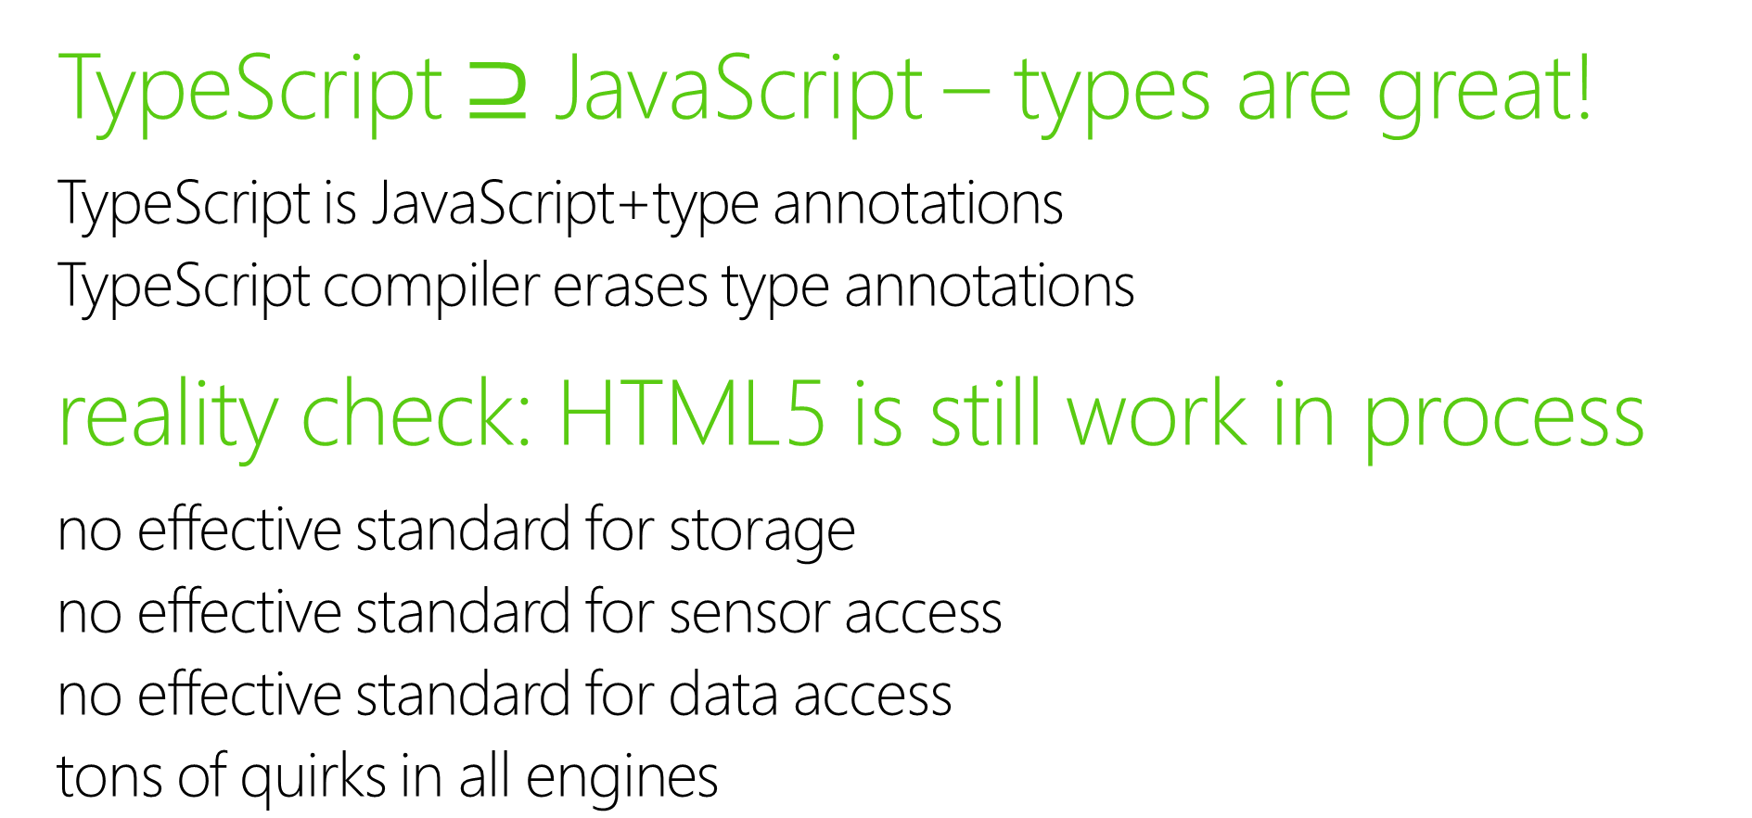
reflections after building web app
TypeScript $⊇$ JavaScript – types are great!
TypeScript is JavaScript+type annotations
TypeScript compiler erases type annotations
reality check: HTML5 is still work in process
no effective standard for storage
no effective standard for sensor access
no effective standard for data access
tons of quirks in all engines
touchdevelop.com/help/platforms

Slide 137

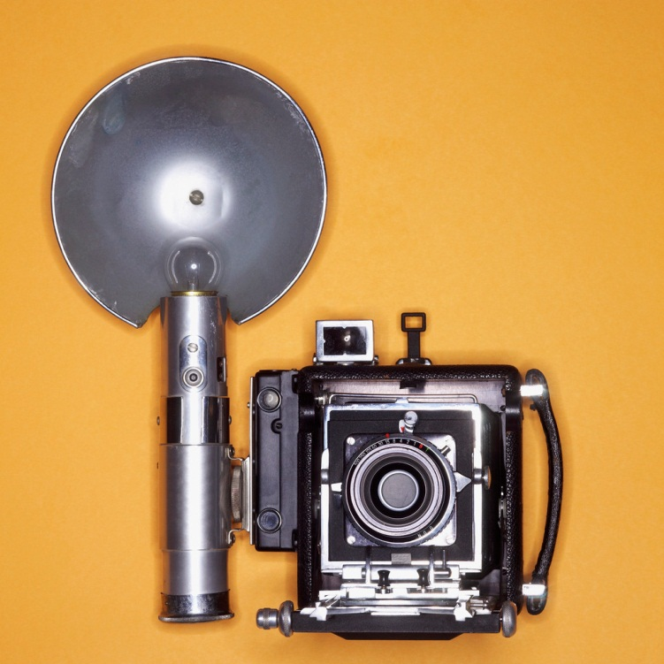
access to sensors and data
camera?, touch, accelerometer?, compass?, radio?, gyroscope?, microphone?, location, phone?,
contacts?, calendar?, email, pictures?, songs?,
web queries, search, maps, social networks,
oauth v2, graphics with physics engine,
forms with automatic layout, …
x?: depends on your device and browser
touchdevelop.com/help/platforms

Slide 138
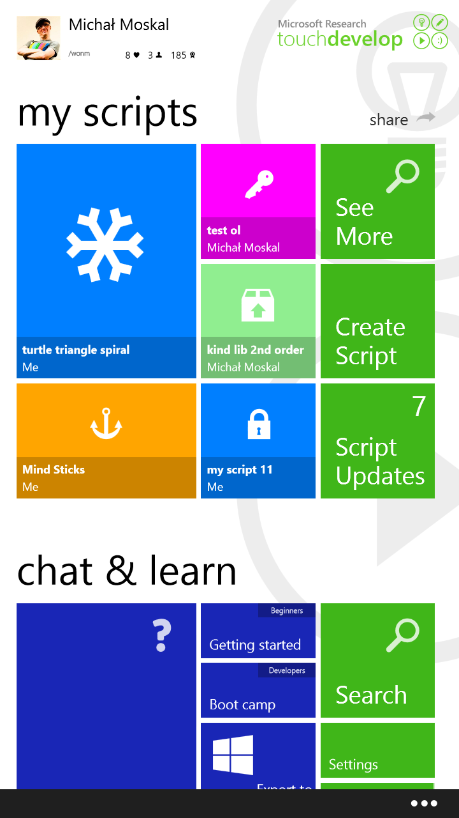
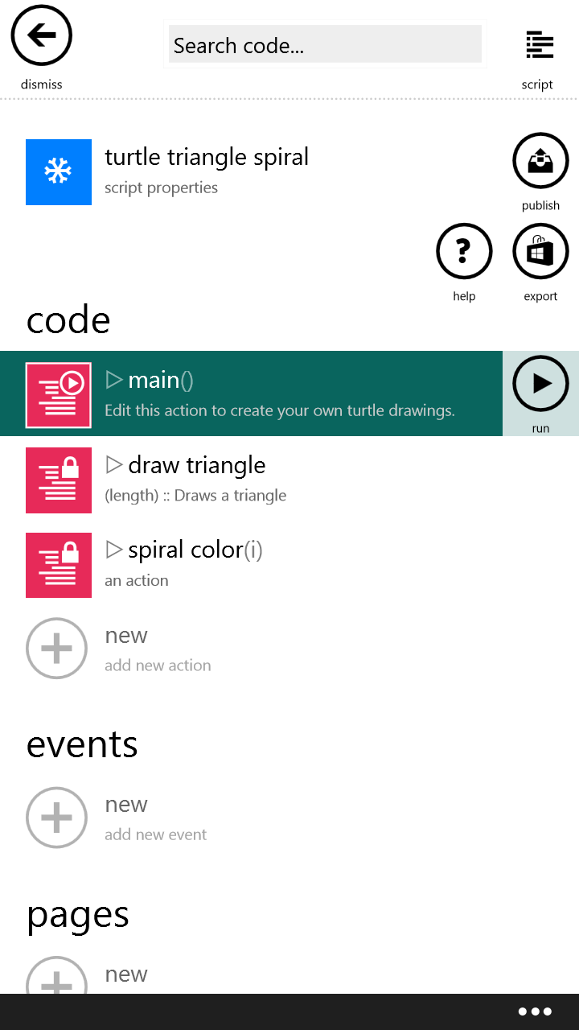
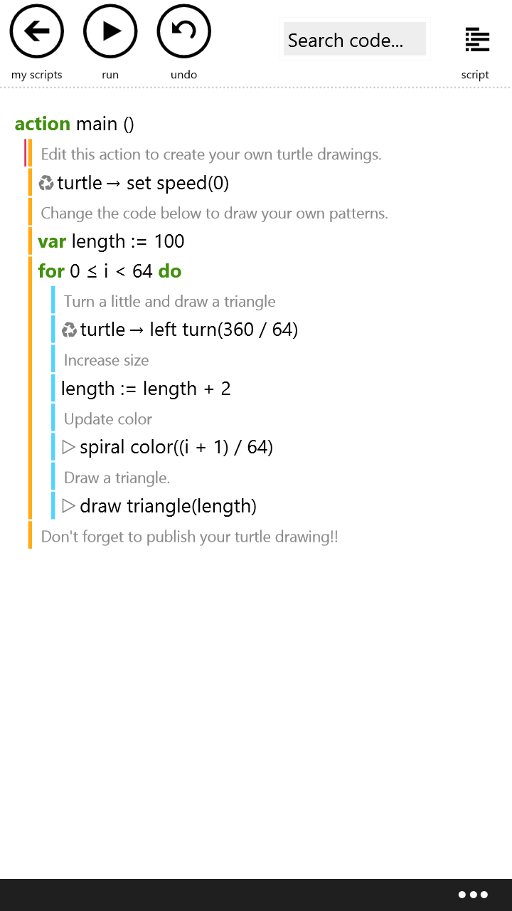
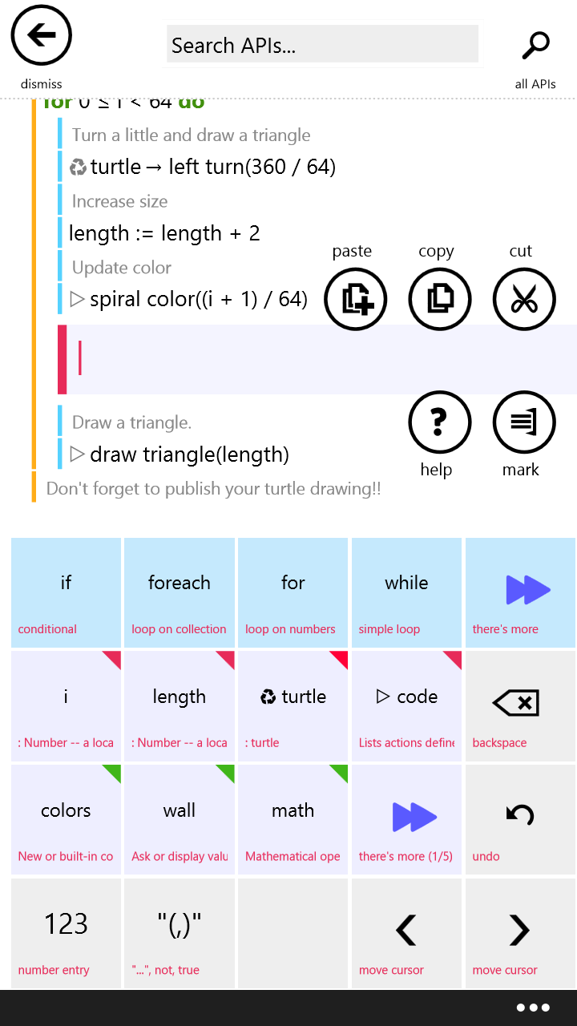
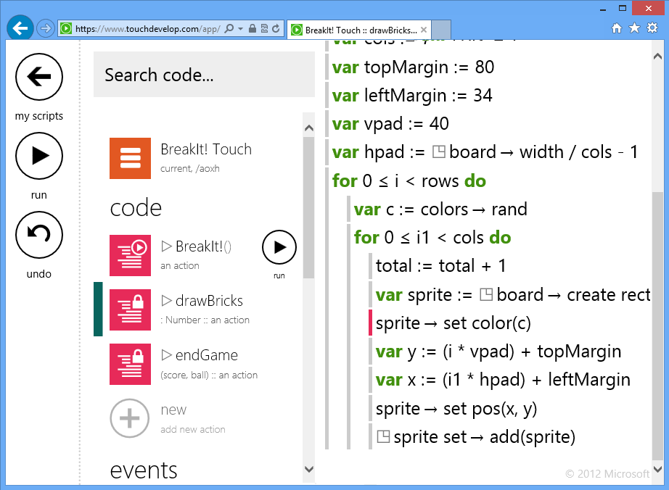
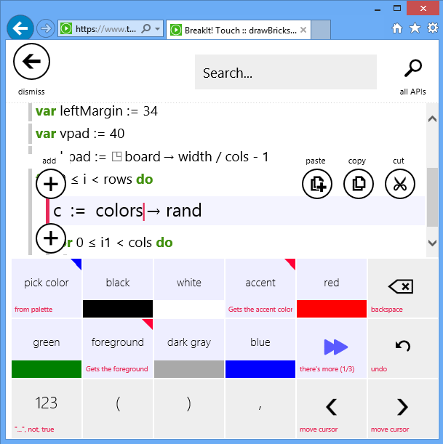
touchdevelop: a touch-first IDE
Windows Phone app
access to most sensors
web app
iPhone, iPad,
Android (w/ WAB)
Windows, Mac, Linux
Notes:
mention:
refactorings in code editor
references to songs, images from the web
physics engine for games
libraries
…

